Slide 1

Mepco Schlenk Engineering College (Autonomous)
19CS694 – WEB USER INTERFACE DESIGN
VENUE BOOKING
MANAGEMENT SYSTEM
SANJITH.S.C (Reg. No. :9517202104133)
KARTHIK.R (Reg. No. : 9517202104255)
Department of Computer Science and Engineering
1

Slide 2
Mepco Schlenk Engineering College (Autonomous)
Problem Description:
The purpose of the Venue Booking Management System is to efficiently manage the booking and reservation of venues. Here, the process begins as the customer gets themselves registered in the system, and then they have the provision to browse and book their required venues. Once they have placed their booking, they can now maintain their history of the venues booked. The admin has the provision of adding, removing the venue details in the inventory. The admin can track the venues and the customers who have made bookings.
26 April 2024
26 April 2024
26 April 2024
26 April 2024
26 April 2024
26 April 2024
26 April 2024
Department of Computer Science and Engineering
2

Slide 3
Mepco Schlenk Engineering College (Autonomous)
Objective:
The main objective of this system is:
To simplify the booking process for venues.
To efficiently manage venue availability and details.
To provide a user-friendly interface for customers and administrators.
26 April 2024
26 April 2024
26 April 2024
26 April 2024
26 April 2024
26 April 2024
26 April 2024
Department of Computer Science and Engineering
3

Slide 4
Mepco Schlenk Engineering College (Autonomous)
OUTCOME:
The outcome of the Venue Booking Management system which uses Angular and MongoDB would help
To provide an improved user experience with an intuitive interface for easier navigation and quicker bookings.
To achieve efficient management of bookings and venue schedules, reducing conflicts and overlaps.
26 April 2024
26 April 2024
26 April 2024
26 April 2024
26 April 2024
26 April 2024
26 April 2024
Department of Computer Science and Engineering
4

Slide 5
Mepco Schlenk Engineering College (Autonomous)
ARCHITECTURE DESIGN:
An architectural diagram illustrates the flow of the system. The flow begins by determining whether the user has an account. If the user has an account, they are directed to the login page. After logging into the system, it enables the user to search for available venues and make a booking. Once the booking is confirmed, the user can view details of their booking, manage or modify it as needed, and eventually log out.
Department of Computer Science and Engineering
5

Slide 6
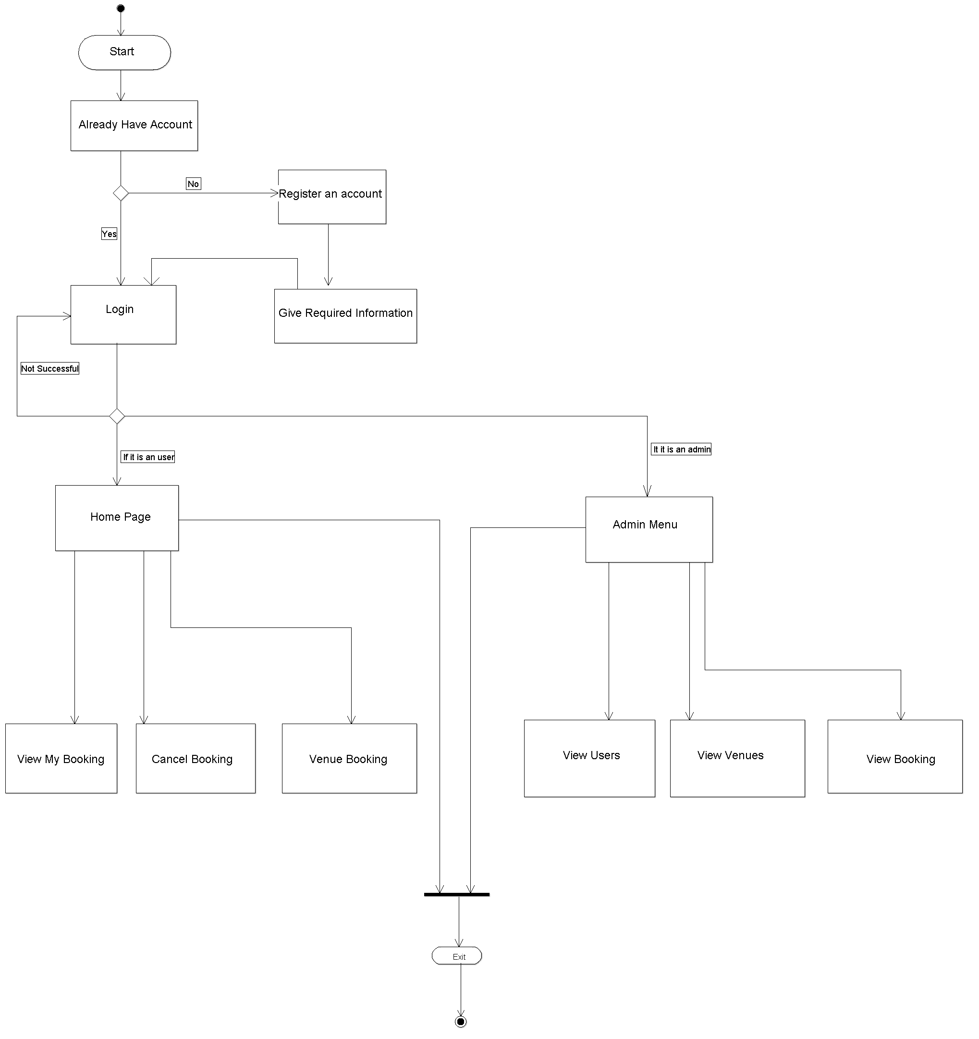
Mepco Schlenk Engineering College (Autonomous)
26 April 2024
Department of Computer Science and Engineering
6

Slide 7
Mepco Schlenk Engineering College (Autonomous)
Modules:
Listed below gives a description of database document schemas used for the Vanue Booking Management System.
Venue Description
User Description
Booking Description
26 April 2024
26 April 2024
Department of Computer Science and Engineering
7

Slide 8
Mepco Schlenk Engineering College (Autonomous)
User Structure:
Attribute Name | Type | Width | Constraint(s) | Description
Username | String | 20 | Not Null | Username
Gender | String | 6 | Not Null | Gender of the user
Phone Number | Integer | 10 | Not Null | Phone number of the user
Email-id | String | 20 | Not Null | Mail id of the user
Password | String | 20 | Not Null | Password of the user used for login details
The User description has the attributes such as the username, gender, phone number, email-id and password
26 April 2024
26 April 2024
Department of Computer Science and Engineering
8

Slide 9
Mepco Schlenk Engineering College (Autonomous)
Venue Structure
Attribute Name | Type | Width | Constraint(s) | Description
Name | String | 20 | Not Null | Name of the venue
Seating Capacity | Integer | 5 | Not Null | Seating Capacity of the venue
City | String | 20 | Not Null | City of the user
AC | String | 3 | Not Null | AC availability
Parking Capacity | Integer | 5 | Not Null | Parking capacity for the venue
Room Availability | Integer | 5 | Not Null | Rooms available in the venue
The venue structure has the description required for the user and has the attributes such as the name, seating capacity, city, ac, parking capacity and rooms availability.
26 April 2024
26 April 2024
Department of Computer Science and Engineering
9

Slide 10
Mepco Schlenk Engineering College (Autonomous)
Booking Structure
Attribute Name | Type | Width | Constraint(s) | Description
Username | String | 20 | Not Null | Username of the venue
Hall Name | String | 20 | Not Null | Hall name of the venue
Date | String | 10 | Not Null | Date of the booking
The Booking structure has the attributes such as the username, hall name and the date for the booking that is made by the customer.
26 April 2024
26 April 2024
Department of Computer Science and Engineering
10

Slide 11
Mepco Schlenk Engineering College (Autonomous)
LOW LEVEL DESIGN
Login Details:
Files used | TypeScript/login.component.ts
Short Description | Allows the user to login to the application
Arguments | Username, Password
Return | Success/Failure in login
Pre-Condition | The user must have an account
Post-Condition | The home page will be displayed
Exception | Invalid username and password
Actor | User
26 April 2024
26 April 2024
Department of Computer Science and Engineering
11

Slide 12
Mepco Schlenk Engineering College (Autonomous)
Registration Details:
Files used | TypeScript/register.component.ts
Short Description | Allows the user to register to the application
Arguments | Username, Password, Gender, Email, Phone Number
Return | Success/Failure in registration
Pre-Condition | The user must have a email id and phone number
Post-Condition | The login page will be displayed
Exception | Username already exists
Actor | User
26 April 2024
26 April 2024
Department of Computer Science and Engineering
12

Slide 13
Mepco Schlenk Engineering College (Autonomous)
Forget Password Details
Files used | TypeScript/forget.component.ts
Short Description | Allows the user to change the password
Arguments | Username, New Password
Return | Success/Failure in is forget password
Pre-Condition | The user must have an account
Post-Condition | The login page will be displayed
Exception | Invalid Username
Actor | User
26 April 2024
26 April 2024
Department of Computer Science and Engineering
13

Slide 14
Mepco Schlenk Engineering College (Autonomous)
Delete My Account Details
Files used | TypeScript/delete.component.ts
Short Description | Allows the user to delete his/her account
Arguments | Username, Password
Return | Success/Failure
Pre-Condition | The user must have an account
Post-Condition | The landing page will be displayed
Exception | Invalid Username and Password
Actor | User
26 April 2024
26 April 2024
26 April 2024
Department of Computer Science and Engineering
14

Slide 15
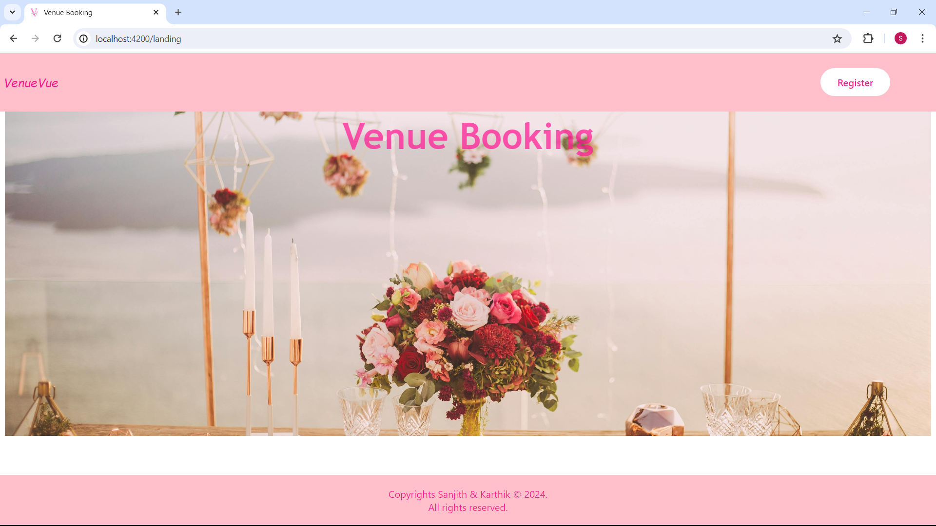
Mepco Schlenk Engineering College (Autonomous)
RESULTS:
Landing page
26 April 2024
26 April 2024
26 April 2024
Department of Computer Science and Engineering
15

Slide 16
Mepco Schlenk Engineering College (Autonomous)
Our Landing Page offers a simple yet inviting introduction to our platform. With just one click, users can embark on their journey by registering for an account through the "Register" button. This seamless transition directs them to the signup page, where they can create their account and begin exploring all that our platform has to offer.
At the bottom of the page, users will find information about the developers behind our platform, showcasing the talent and dedication that went into its creation. As a finishing touch, our Landing Page features a unique favicon, providing a visual representation of our brand identity and ensuring a memorable browsing experience for our users.
26 April 2024
26 April 2024
26 April 2024
Department of Computer Science and Engineering
16

Slide 17
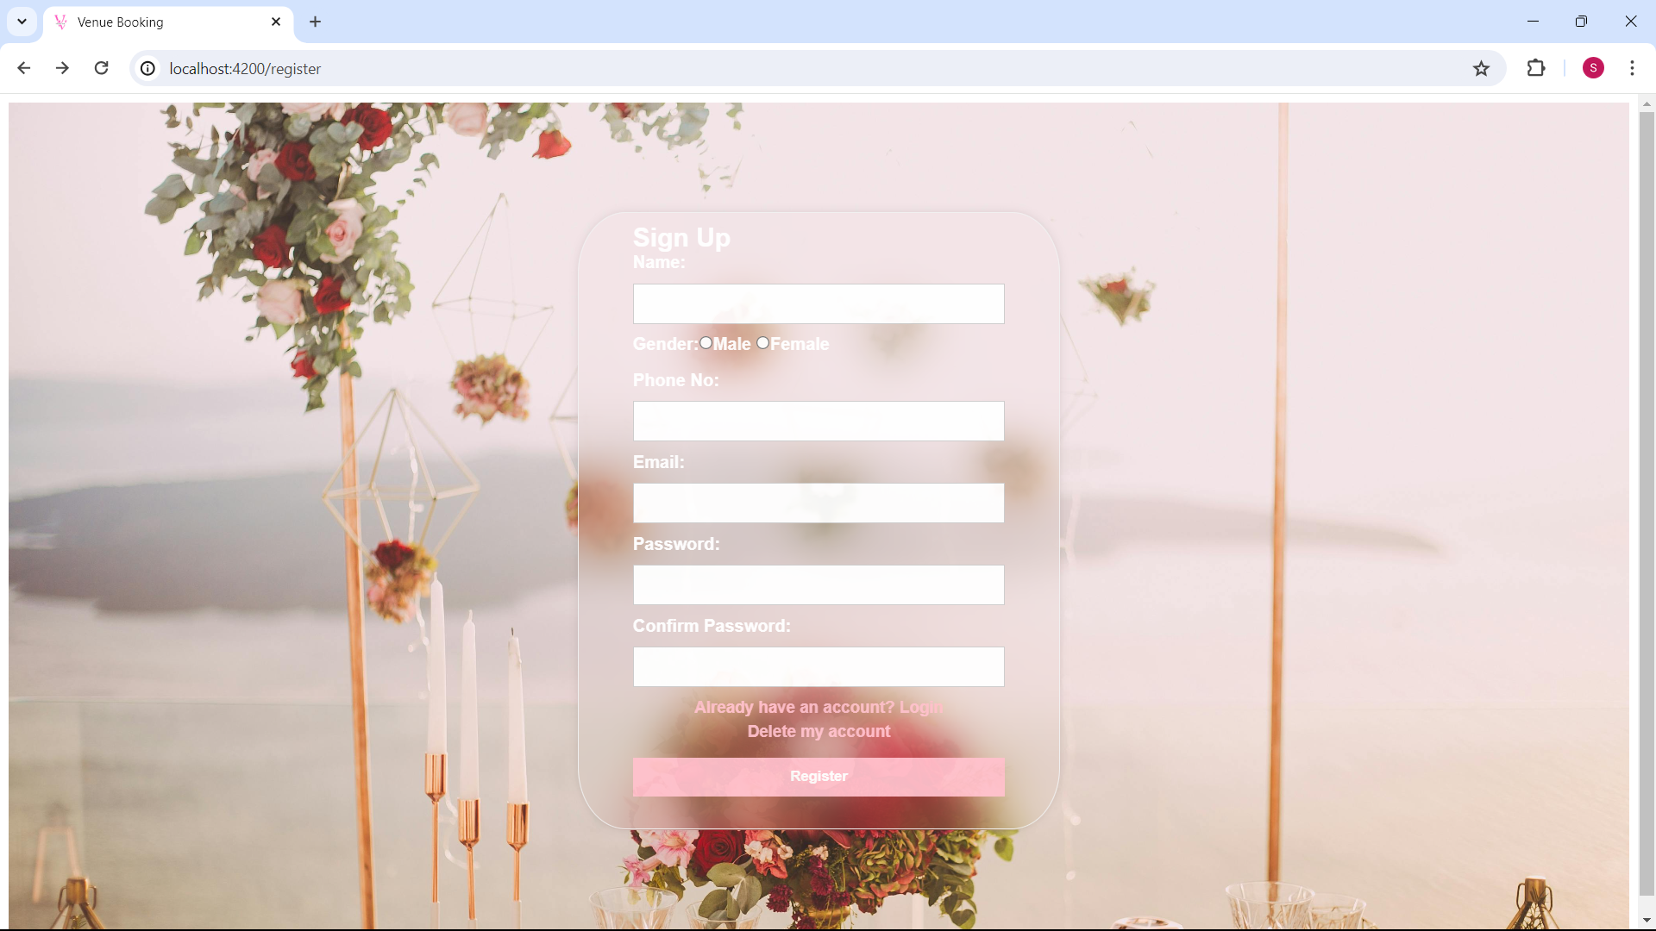
Mepco Schlenk Engineering College (Autonomous)
SignUp Page
26 April 2024
26 April 2024
26 April 2024
Department of Computer Science and Engineering
17

Slide 18
Mepco Schlenk Engineering College (Autonomous)
This interface provides the signup page for the Venue Booking Management System. Customers who wish to book venues must first register in the system. The registration process requires the customer to provide a username, password, and email ID, mobile no, gender. The username must be a valid one to ensure proper login. Additionally, the password must be entered twice (password and confirm password fields) to confirm accuracy and avoid typing errors. After filling out the necessary information and clicking the signup button, the user gets registered in the system and can begin booking venues.
26 April 2024
26 April 2024
26 April 2024
Department of Computer Science and Engineering
18

Slide 19
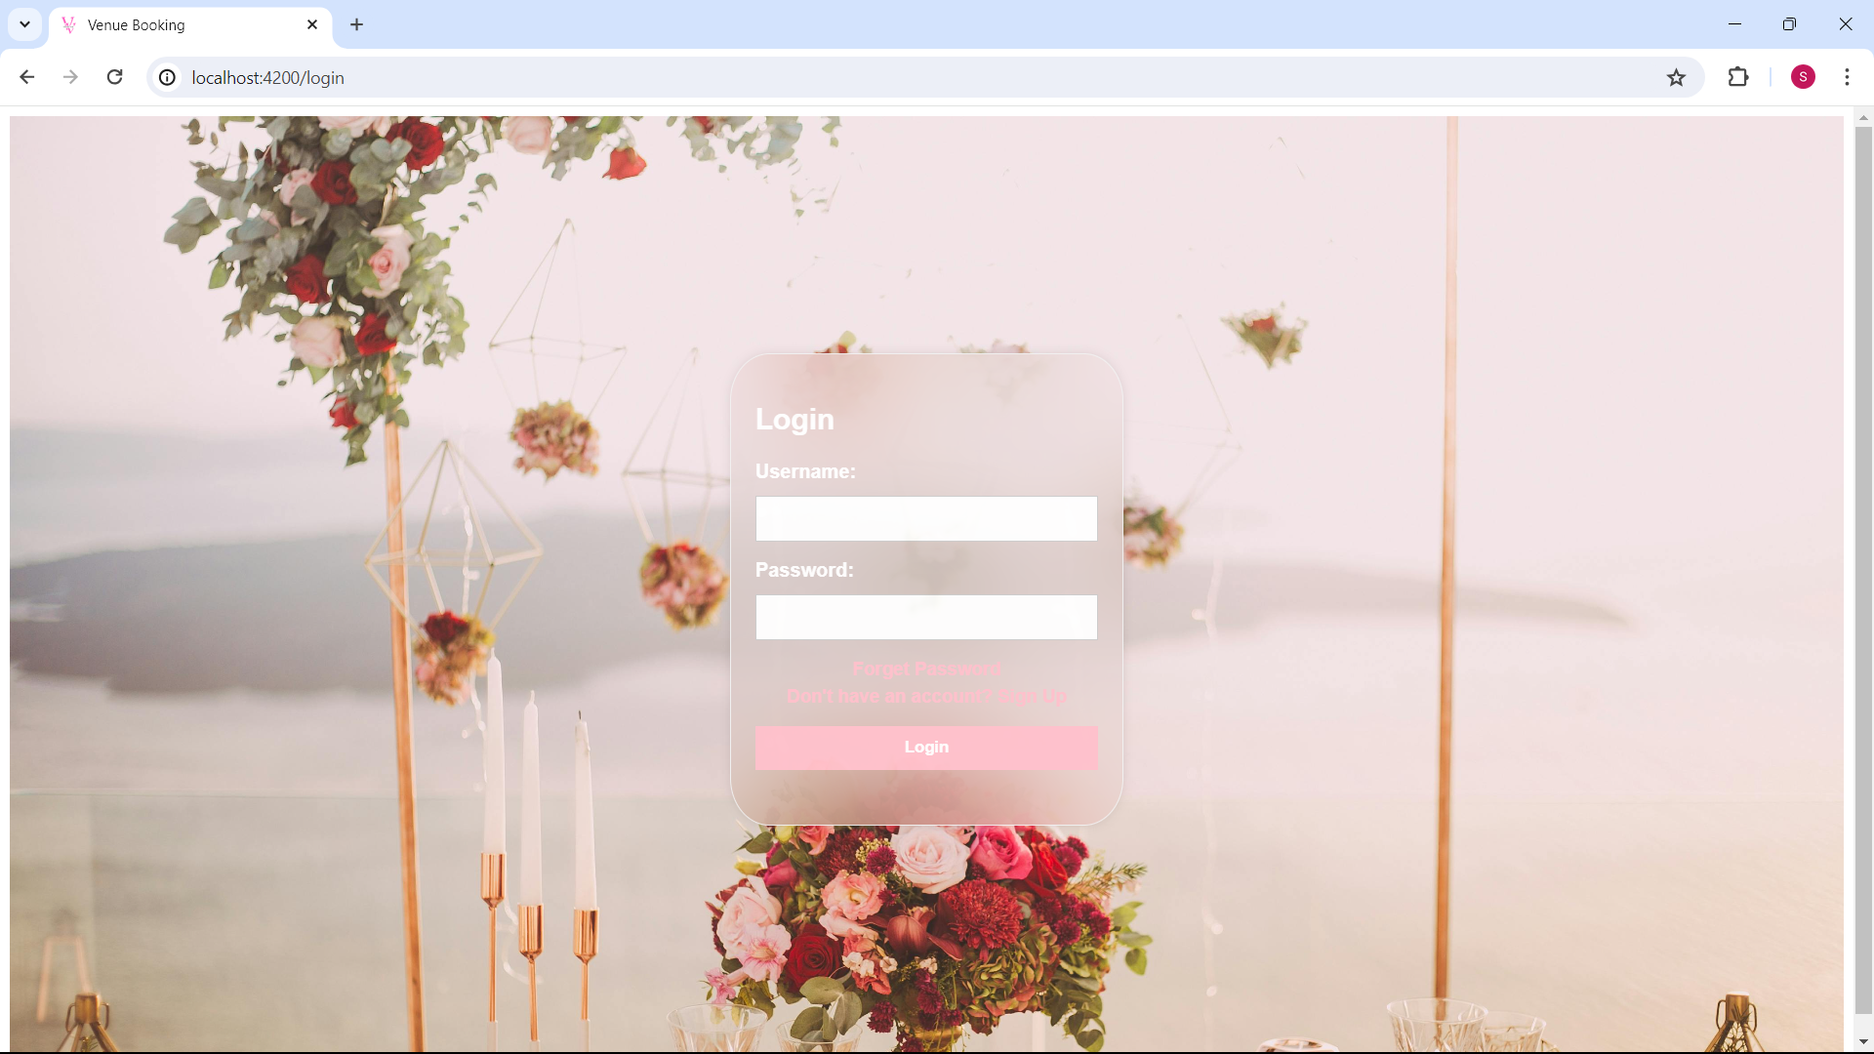
Mepco Schlenk Engineering College (Autonomous)
Login page
26 April 2024
26 April 2024
26 April 2024
Department of Computer Science and Engineering
19

Slide 20
Mepco Schlenk Engineering College (Autonomous)
LoginPage provide the interface for Login to the Venue Booking Management System. This interface provides the registered user to enter into their home page. If the username and the password is correct then the user is allowed to enter into their home page. If the username and the password doesn’t match then the error message of invalid user gets displayed. When the username and the password match with the admin then the dashboard of the admin is displayed.
26 April 2024
26 April 2024
26 April 2024
Department of Computer Science and Engineering
20

Slide 21
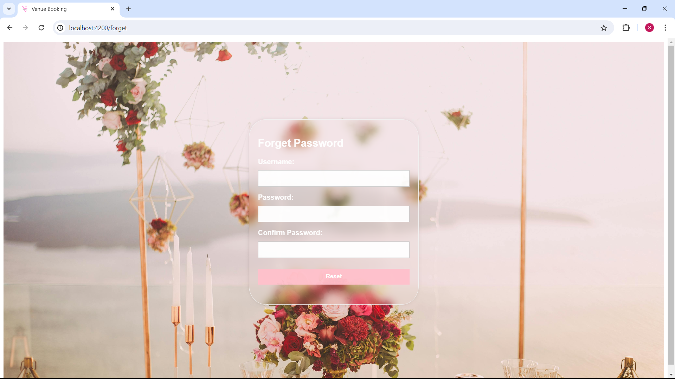
Mepco Schlenk Engineering College (Autonomous)
Forget Password
26 April 2024
26 April 2024
26 April 2024
Department of Computer Science and Engineering
21

Slide 22
Mepco Schlenk Engineering College (Autonomous)
The "Forget Password" interface provides a crucial functionality for users who have forgotten their password. When a user clicks on the "Forget Password" link on the login page, they are directed to this interface where they can change their password by giving their username
26 April 2024
26 April 2024
26 April 2024
Department of Computer Science and Engineering
22

Slide 23

Mepco Schlenk Engineering College (Autonomous)
Delete My Account
26 April 2024
26 April 2024
26 April 2024
Department of Computer Science and Engineering
23

Slide 24
Mepco Schlenk Engineering College (Autonomous)
The "Delete My Account" interface allows users to permanently remove their account from the system. Upon selecting the "Delete My Account" option will result in the deletion of all associated data including booking history, personal information, and any saved preferences. To proceed, the user must confirm their intention by entering their password. This step ensures that the account deletion request is intentional and prevents unauthorized deletions. Once the password is verified, the user can click the final confirmation button to delete their account.
26 April 2024
26 April 2024
26 April 2024
26 April 2024
Department of Computer Science and Engineering
24

Slide 25
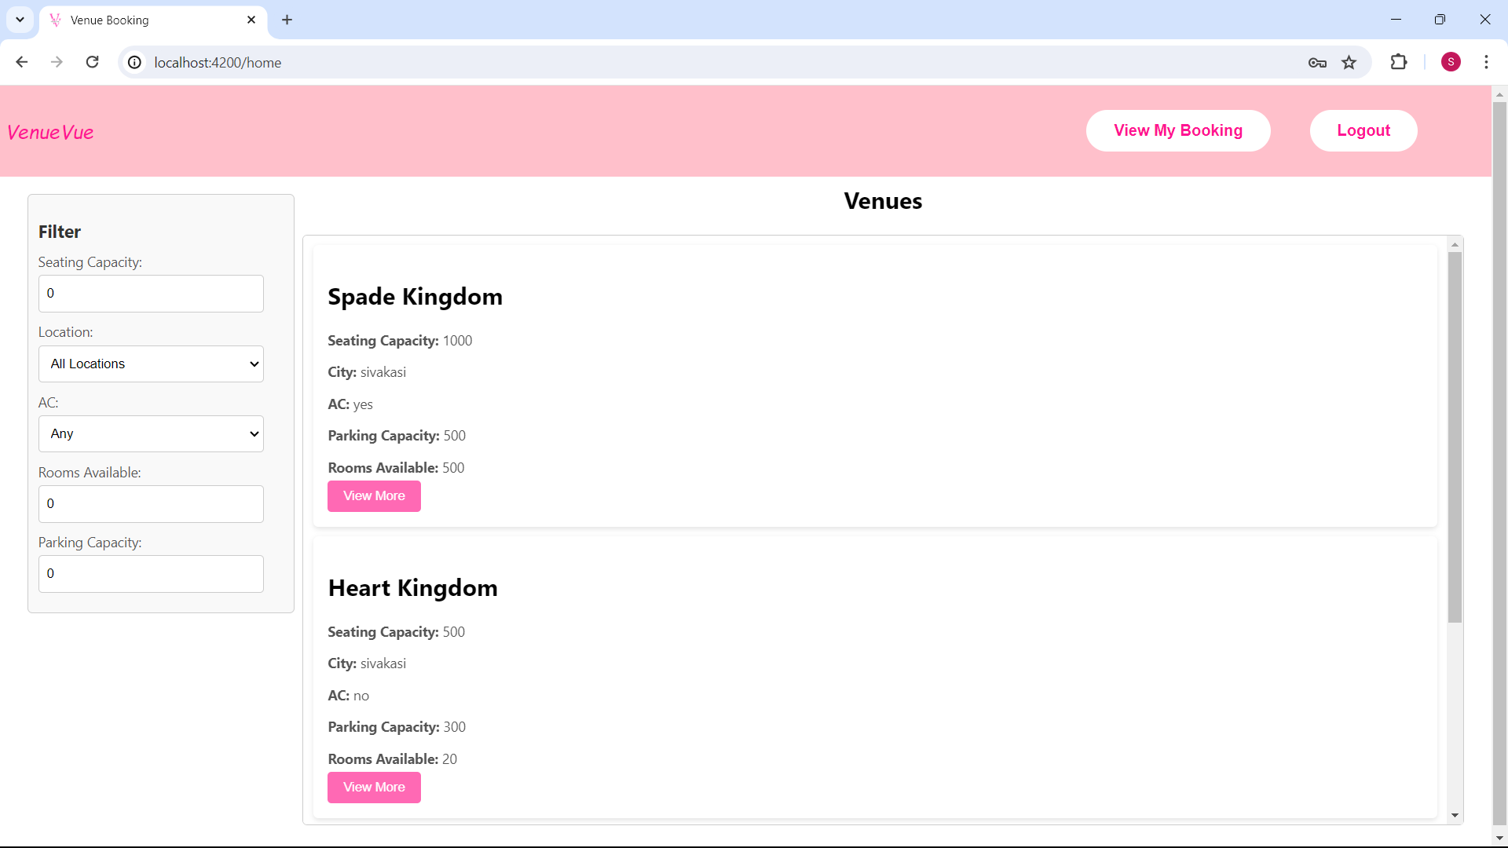
Mepco Schlenk Engineering College (Autonomous)
Home Page
26 April 2024
26 April 2024
26 April 2024
26 April 2024
26 April 2024
Department of Computer Science and Engineering
25

Slide 26
Mepco Schlenk Engineering College (Autonomous)
Welcome to your personalized venue booking dashboard, designed to simplify your venue booking process. With our user-friendly interface, finding the ideal venue is a breeze. Utilize our convenient filter options to customize your search based on location, AC or non-AC preferences, room availability, and parking capacity. Whether you're envisioning a cozy indoor affair or an outdoor extravaganza, we've got you covered. Streamline your search by selecting your desired criteria, ensuring that every aspect of your event aligns perfectly with your vision. Start exploring now and let us help you find the perfect venue to bring your event dreams to life!
26 April 2024
26 April 2024
26 April 2024
26 April 2024
Department of Computer Science and Engineering
26

Slide 27
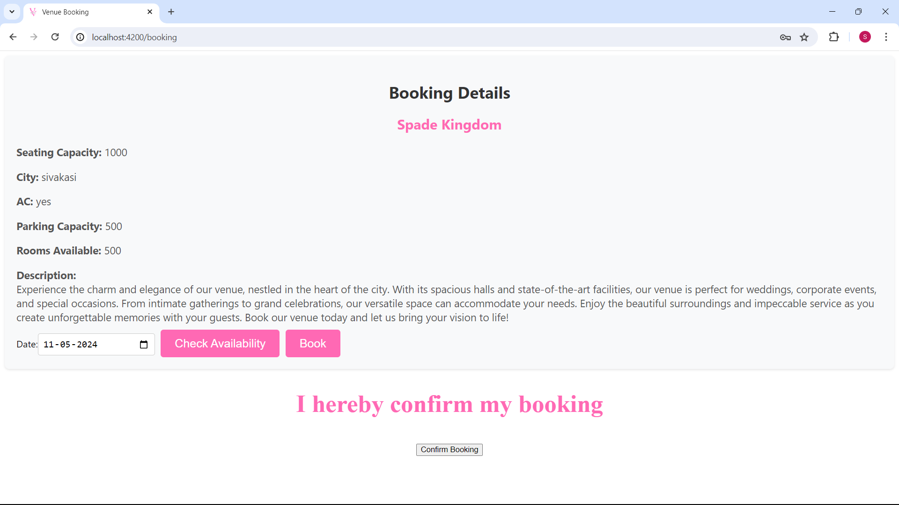
Mepco Schlenk Engineering College (Autonomous)
Booking Page
26 April 2024
26 April 2024
26 April 2024
26 April 2024
26 April 2024
Department of Computer Science and Engineering
27

Slide 28
Mepco Schlenk Engineering College (Autonomous)
Once you've selected your venue, then pick a date for your booking. Check availability of your desired venue on your preferred date. if the Venue is available then proceed to book the venue for your event.
26 April 2024
26 April 2024
26 April 2024
26 April 2024
26 April 2024
Department of Computer Science and Engineering
28

Slide 29
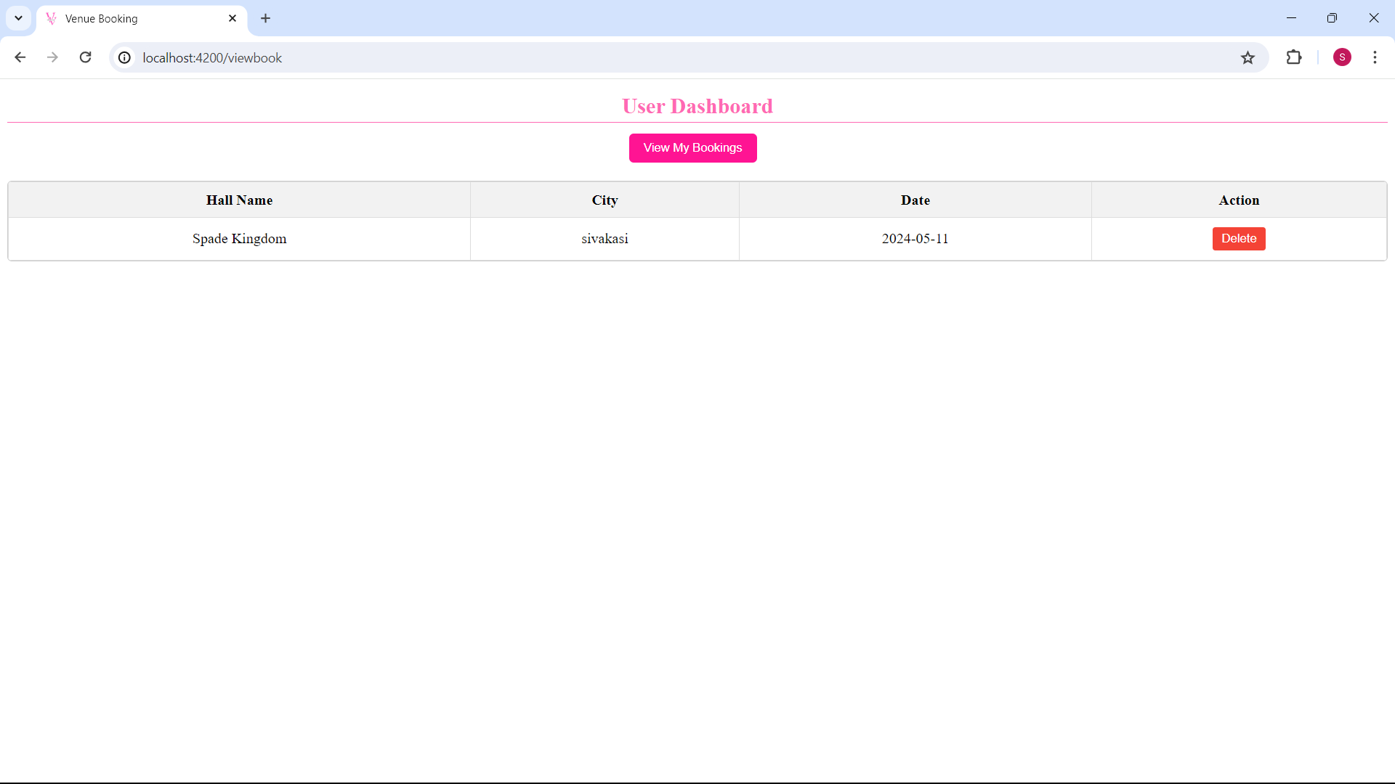
Mepco Schlenk Engineering College (Autonomous)
User Dashboard
26 April 2024
26 April 2024
26 April 2024
26 April 2024
26 April 2024
Department of Computer Science and Engineering
29

Slide 30
Mepco Schlenk Engineering College (Autonomous)
This page serves as your central hub for managing your bookings. Here, you can easily view all your current bookings, including details such as the hall name, city and date of each event. If you need to cancel a booking, simply select the booking you wish to delete and confirm your decision. This will free up the venue for other users and update the availability accordingly.
26 April 2024
26 April 2024
26 April 2024
26 April 2024
26 April 2024
Department of Computer Science and Engineering
30

Slide 31
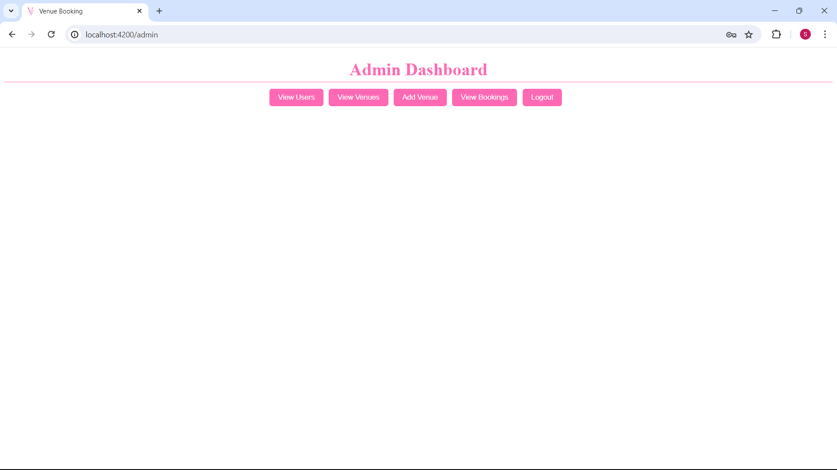
Mepco Schlenk Engineering College (Autonomous)
Admin Dashboard
26 April 2024
26 April 2024
26 April 2024
26 April 2024
26 April 2024
Department of Computer Science and Engineering
31

Slide 32
Mepco Schlenk Engineering College (Autonomous)
Admin can browse through the list of registered users, view their profiles, and access important information such as contact details and booking history and can delete them. Explore collection of venues and access detailed information about each one, including capacity, amenities, and availability and can delete them. Admin can easily adding new venues to the system. Fill in the necessary details such as location, seating capacity, parking capacity, ac or non ac. stay informed about all bookings made within the system. Track booking history to ensure smooth operations.
26 April 2024
26 April 2024
26 April 2024
26 April 2024
26 April 2024
Department of Computer Science and Engineering
32

Slide 33
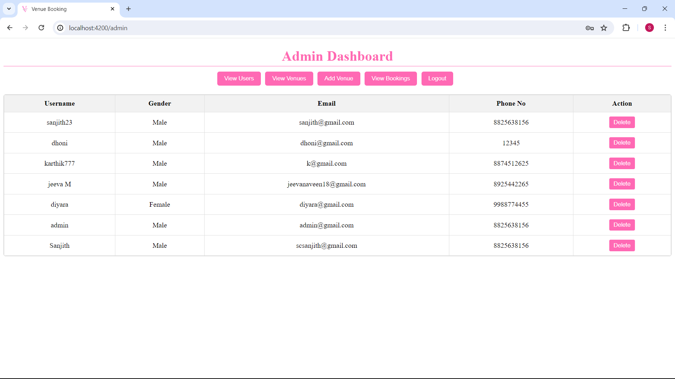
Mepco Schlenk Engineering College (Autonomous)
View User Deails
26 April 2024
26 April 2024
26 April 2024
26 April 2024
26 April 2024
Department of Computer Science and Engineering
33

Slide 34
Mepco Schlenk Engineering College (Autonomous)
In the Admin Dashboard of our Venue Booking Management System, administrators can easily view registered users. Access user profiles and essential details such as contact information. perform essential management tasks, including deleting user accounts if necessary. This feature allows administrators to maintain user databases accurately and securely.
26 April 2024
26 April 2024
26 April 2024
26 April 2024
26 April 2024
Department of Computer Science and Engineering
34

Slide 35
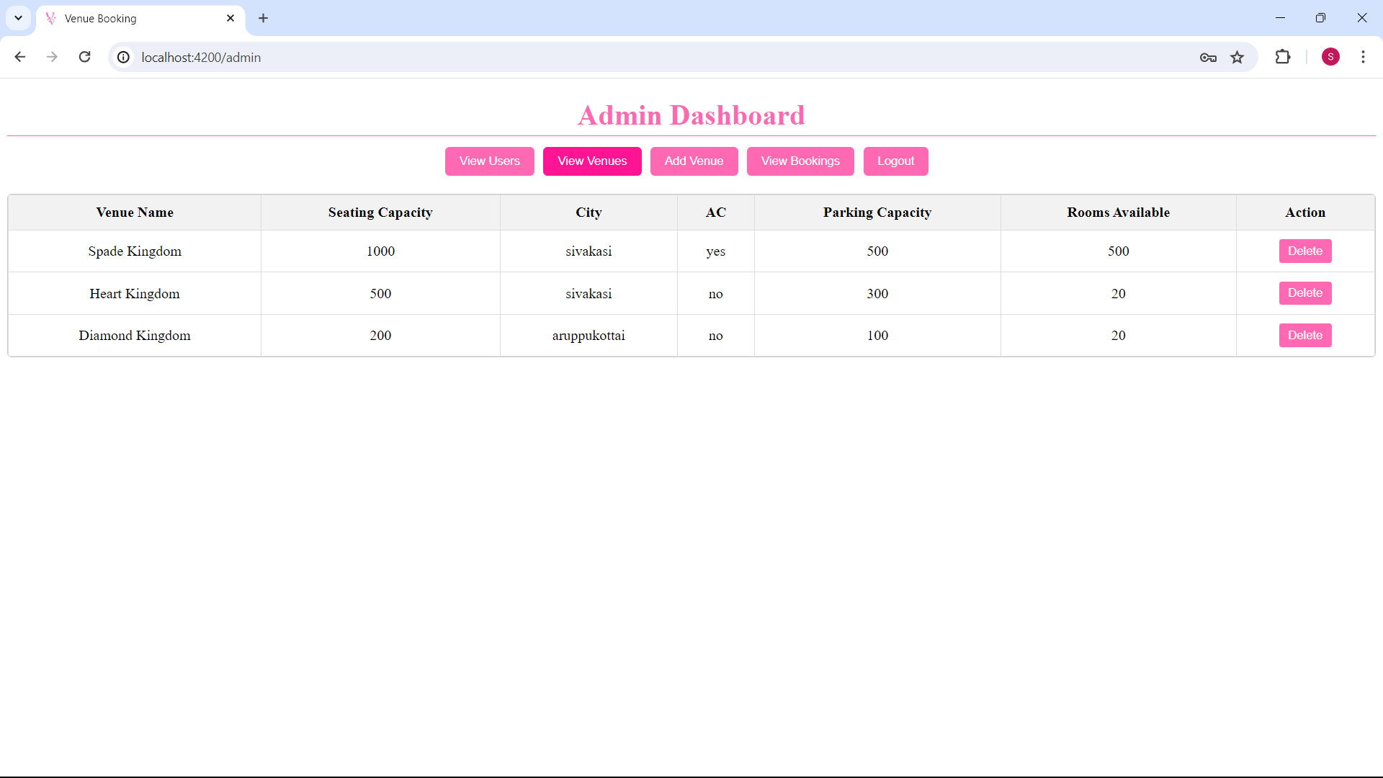
Mepco Schlenk Engineering College (Autonomous)
View Venue Details
26 April 2024
26 April 2024
26 April 2024
26 April 2024
26 April 2024
Department of Computer Science and Engineering
35

Slide 36
Mepco Schlenk Engineering College (Autonomous)
In the Admin Dashboard of our Venue Booking Management System, administrators can easily access detailed venue information. This includes capacity, amenities, location and ac or non ac for each venue. Admin can access and manage venue details, including the option to delete venues when necessary.
26 April 2024
26 April 2024
26 April 2024
26 April 2024
26 April 2024
Department of Computer Science and Engineering
36

Slide 37
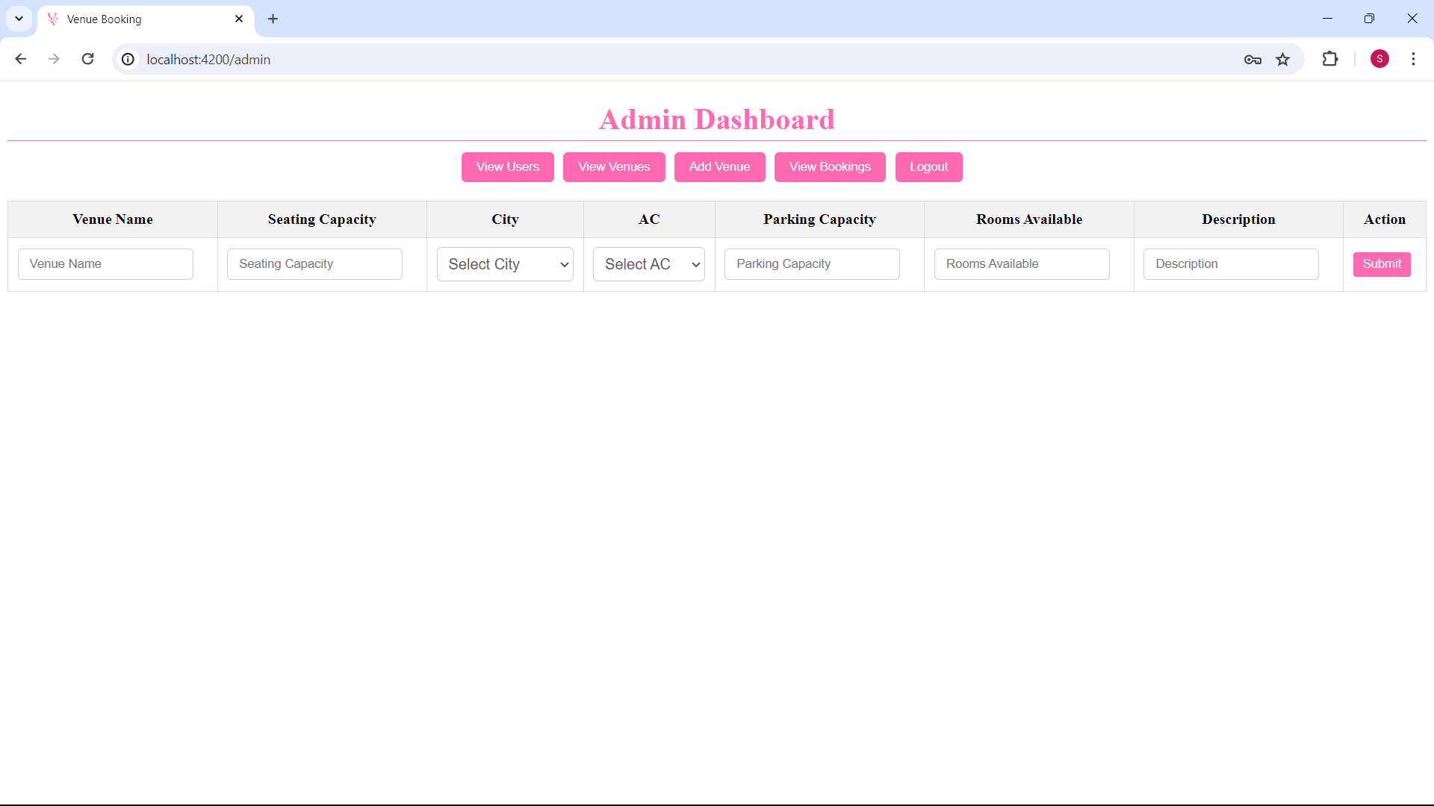
Mepco Schlenk Engineering College (Autonomous)
Add Venue
26 April 2024
26 April 2024
26 April 2024
26 April 2024
26 April 2024
Department of Computer Science and Engineering
37

Slide 38
Mepco Schlenk Engineering College (Autonomous)
Adding a venue in our Venue Booking Management System is a straightforward process that enables administrators to expand the selection of available spaces. Administrators can input essential details such as the venue's name, location, capacity, amenities, and description. By adding venues, administrators can enhance the overall user experience, providing users with more options to choose from when booking their events.
26 April 2024
26 April 2024
26 April 2024
26 April 2024
26 April 2024
Department of Computer Science and Engineering
38

Slide 39
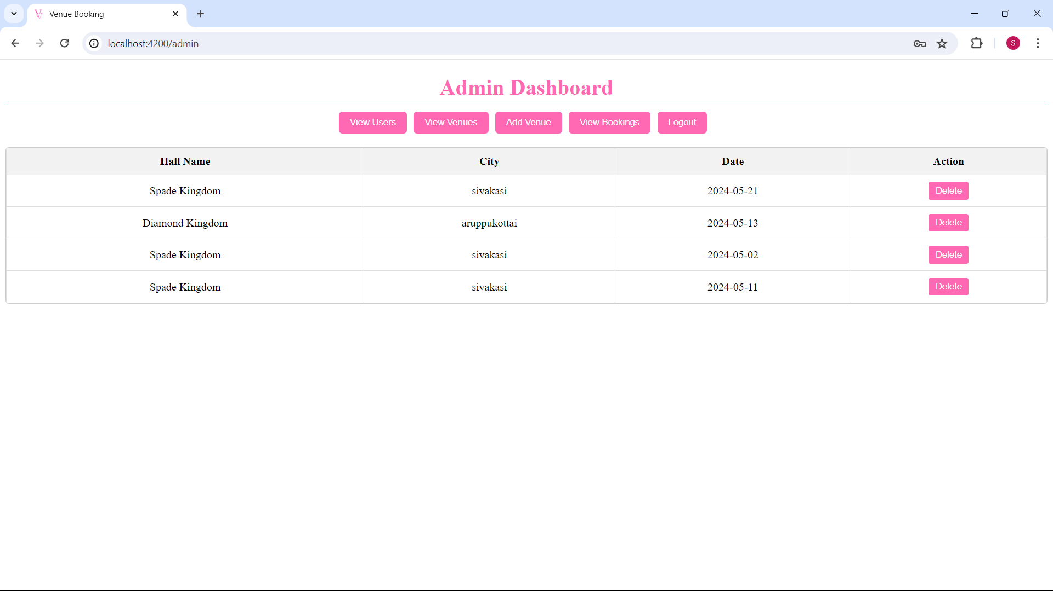
Mepco Schlenk Engineering College (Autonomous)
View Bookings
26 April 2024
26 April 2024
26 April 2024
26 April 2024
26 April 2024
Department of Computer Science and Engineering
39

Slide 40
Mepco Schlenk Engineering College (Autonomous)
In the Admin Dashboard of our Venue Booking Management System, administrators can easily oversee all bookings made within the system. They have access to a detailed list of bookings, including user details, venue information, and event dates. One essential function is the ability to delete bookings when necessary. This feature allows administrators to remove invalid or problematic bookings from the system. By doing so, they maintain the integrity of the booking database and prevent any issues that may arise from inaccurate or conflicting bookings.
26 April 2024
26 April 2024
26 April 2024
26 April 2024
26 April 2024
Department of Computer Science and Engineering
40

Slide 41
Mepco Schlenk Engineering College (Autonomous)
CONCLUSION AND FURTHER ENHANCEMENTS
The Venue Management System represents a significant step forward in streamlining venue booking processes and enhancing the overall user experience. By providing a centralized platform for venue owners and event organizers to connect and collaborate, the system fosters efficiency and convenience in managing venues for various events. Moving forward, potential enhancements could include the integration of advanced analytics capabilities to provide insights into venue utilization and user preferences, allowing for more informed decision-making and strategic planning. Additionally, future iterations of the system could incorporate features such as automated scheduling algorithms to optimize venue allocation and minimize conflicts. Furthermore, enhancing the system's communication capabilities, such as real-time messaging and notification functionalities, could further improve collaboration and coordination between venue owners and event organizers. Overall, the Venue Management System holds great potential for continued growth and evolution, offering opportunities to further streamline venue management processes and deliver enhanced value to users across the board.
26 April 2024
26 April 2024
26 April 2024
26 April 2024
26 April 2024
26 April 2024
Department of Computer Science and Engineering
41

Slide 42
Mepco Schlenk Engineering College (Autonomous)
THANK YOU
26 April 2024
26 April 2024
26 April 2024
26 April 2024
26 April 2024
26 April 2024
26 April 2024
Department of Computer Science and Engineering
42

